Slide 1
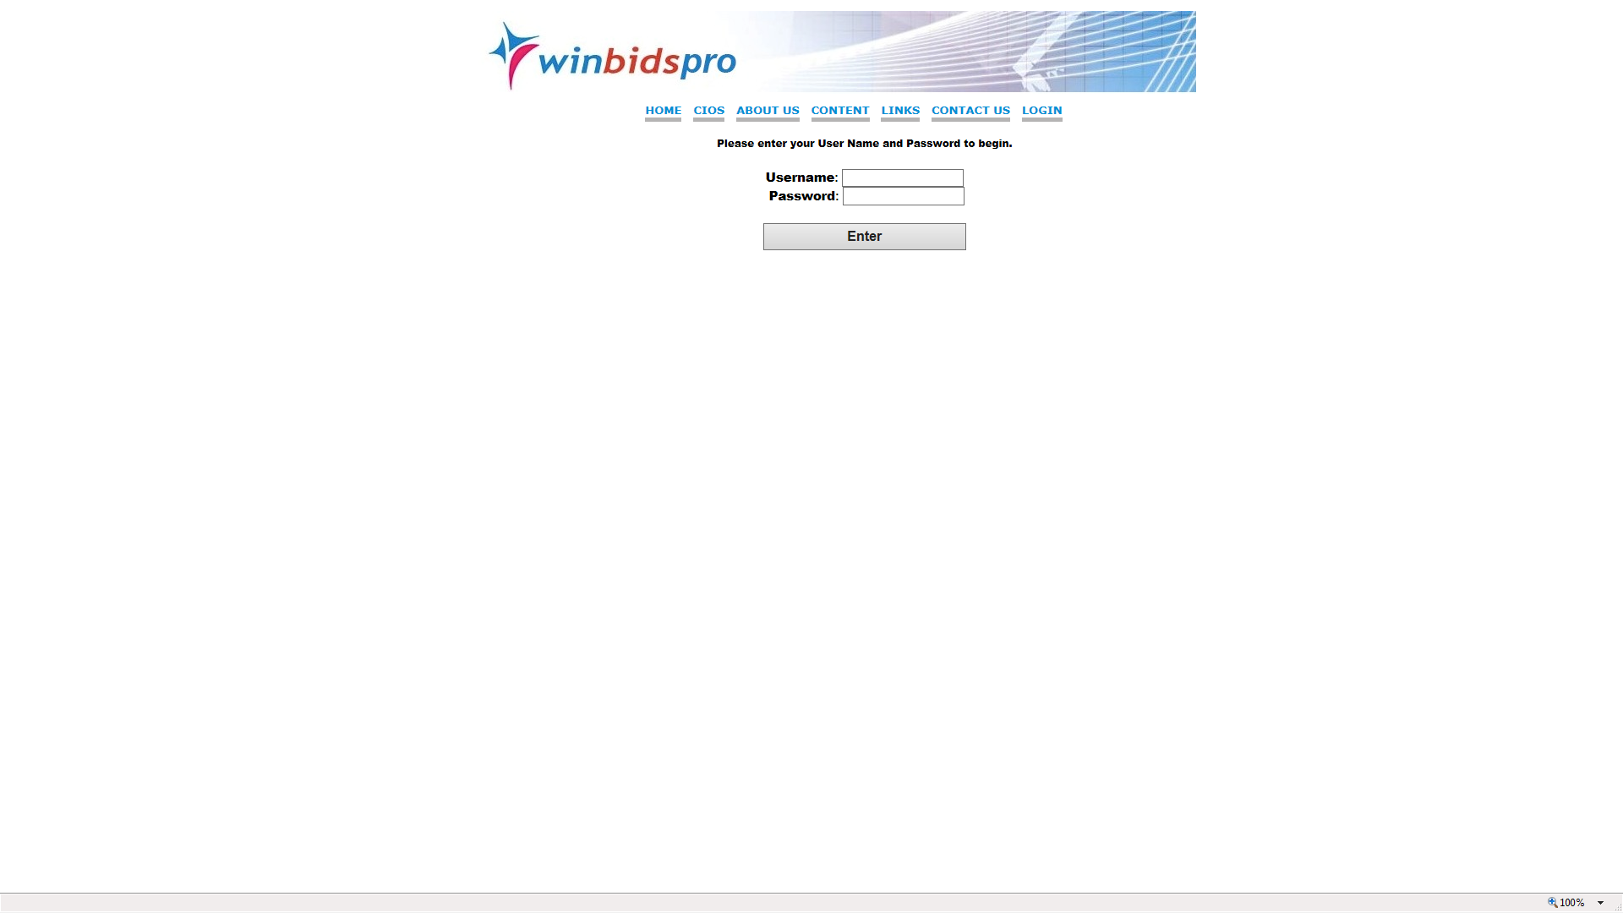
Each user is assigned a username as well as a password –
multiple users may use the same password but only one at a time
The WinBids Pro database provides research data as well as marketing knowledge and comprehensive bid opportunities unlike ANY company or Government organization in the world

Slide 2
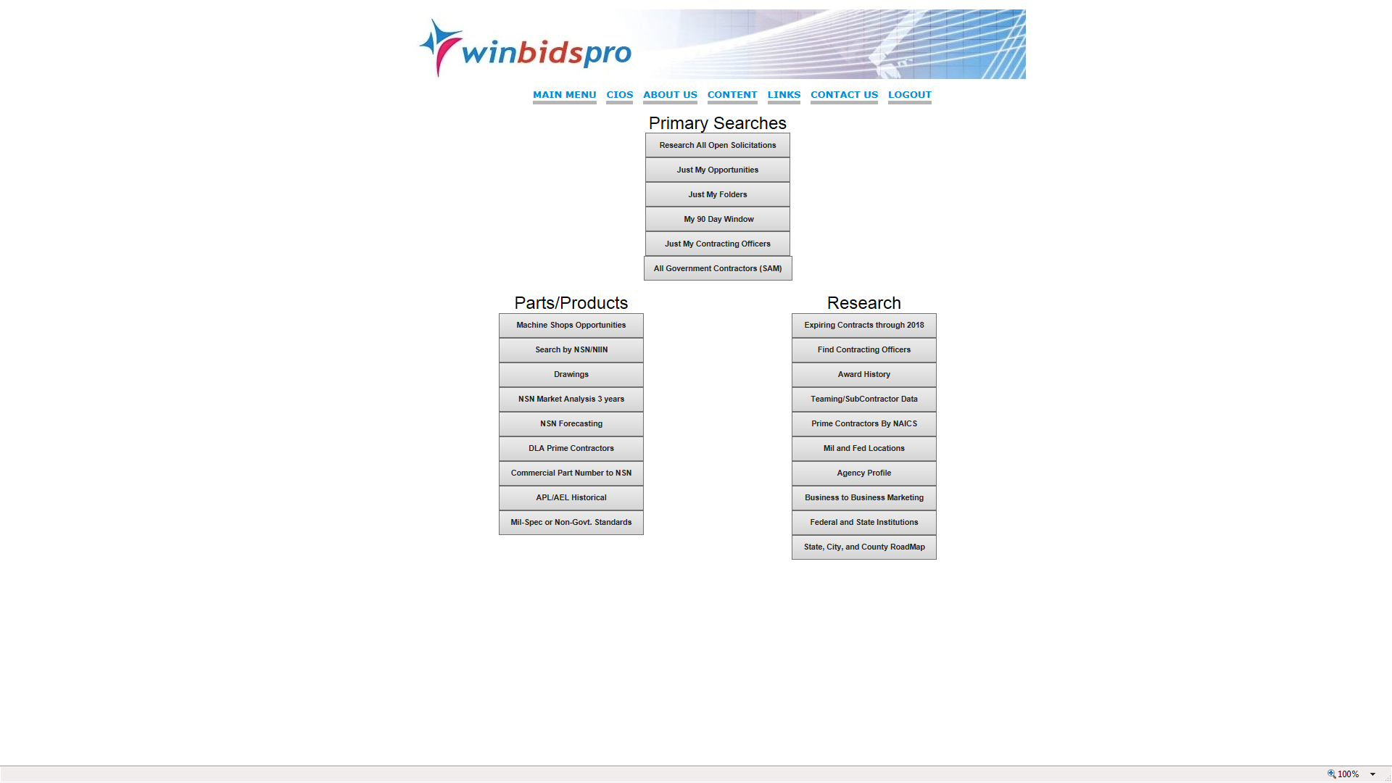
The WinBids Pro database is organized to allow the user to do market research on what is being acquired by the Government- who are the acquisition people involved- who is the current incumbent contractors and so on- all research you require to successfully market to either the Military or Federal Government. WinBids Pro also provides two databases, one via email and one in theWinBids Pro system that notifies you of any opportunity that matches a profile that your organization and WinBids Pro set up. The daily emails contain not only salient bid response information but technical data that may be required RESEARCH- MARKETING- SALES ASSISTANCE

Slide 3
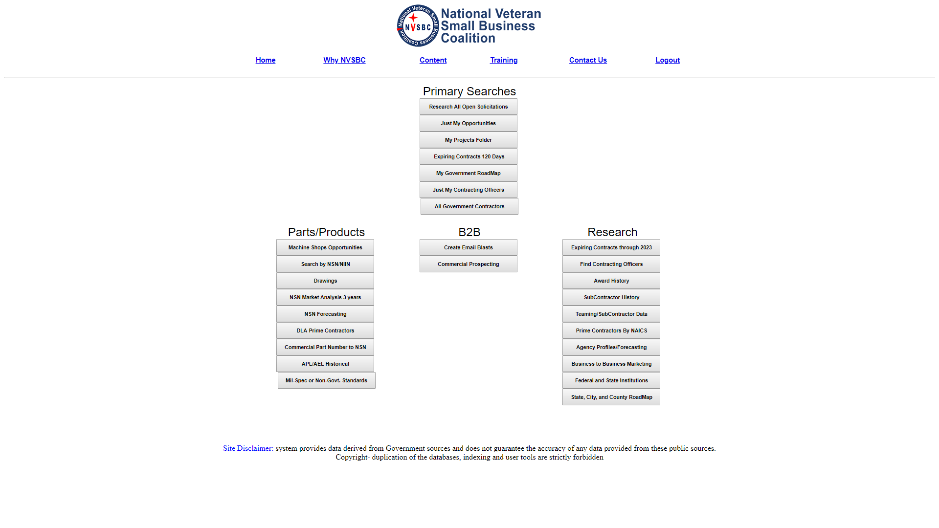
The WinBids Pro database is organized to allow the user to do market research on what is being acquired by the Government- who are the acquisition people involved- who is the current incumbent contractors and so on- all research you require to successfully market to either the Military or Federal Government. WinBids Pro also provides two databases, one via email and one in theWinBids Pro system that notifies you of any opportunity that matches a profile that your organization and WinBids Pro set up. The daily emails contain not only salient bid response information but technical data that may be required RESEARCH- MARKETING- SALES ASSISTANCE

Slide 4
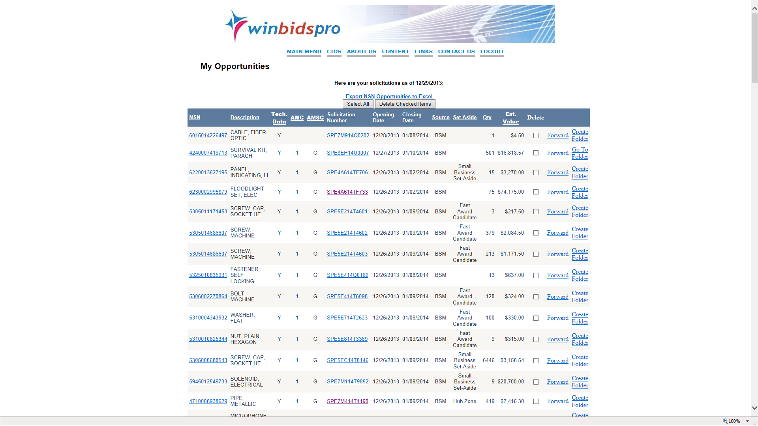
Home | Why NVSBC | Content | Training | Contact Us | Logout
Daily bid notices either via email or in the WinBids Pro database show how much the bid may be worth and is a unique WinBids Pro feature which no one provides. In the world of parts WinBids Pro provides award history back to 1965 on ALL successful contract awards. By “clicking” on the NSN tech data links will appear. Bid data comes from 3 Army sites- all Air Force- Navy and DLA as well as FBO

Slide 5
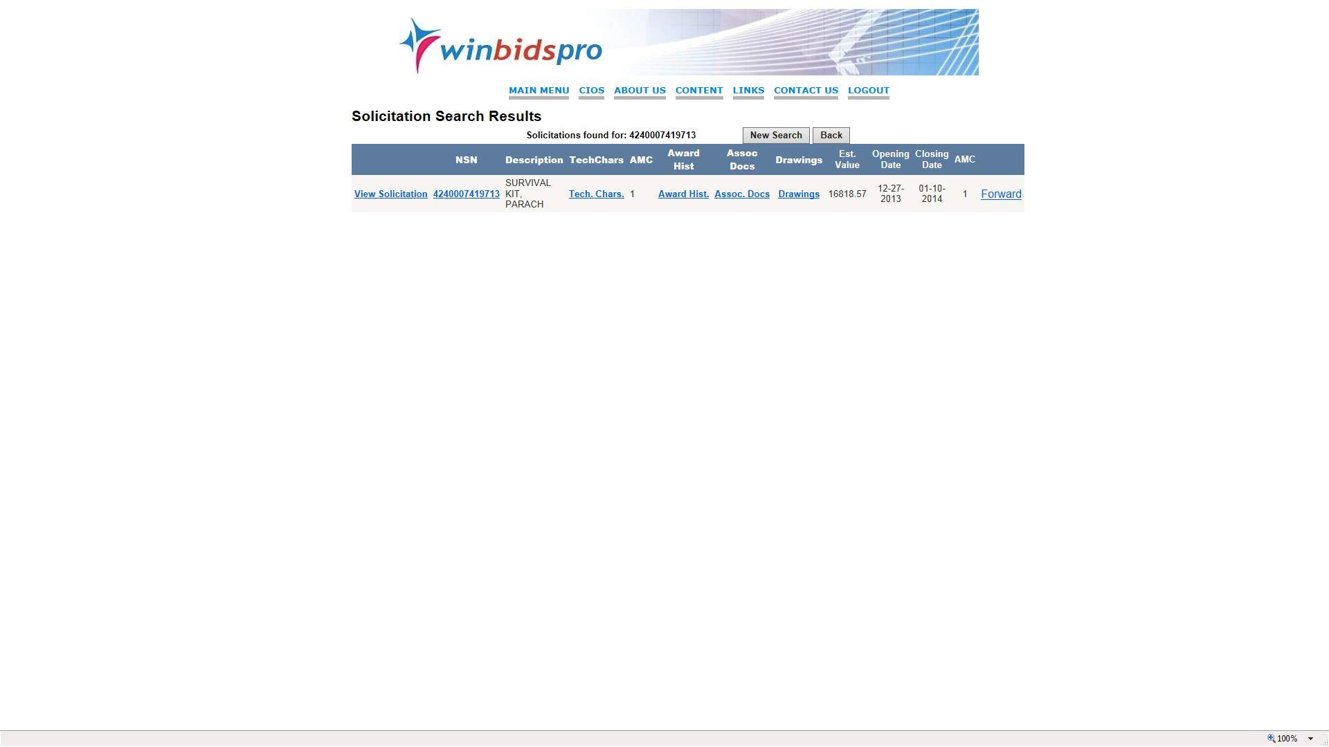
Home | Why NVSBC | Content | Training | Contact Us | Logout
Each data element in the data display of the daily opportunities opens up key technical data or award history of successful awards to competitors Daily bid notices either via email or in the WinBids Pro database show how much the bid may be worth and is a unique WinBids Pro feature which no one provides. In the world of parts WinBids Pro provides award history back to 1965 on ALL successful contract awards. By “clicking” on the NSN tech data links will appear. Bid data comes from 3 Army sites- all Air Force- Navy and DLA as well as FBO

Slide 6
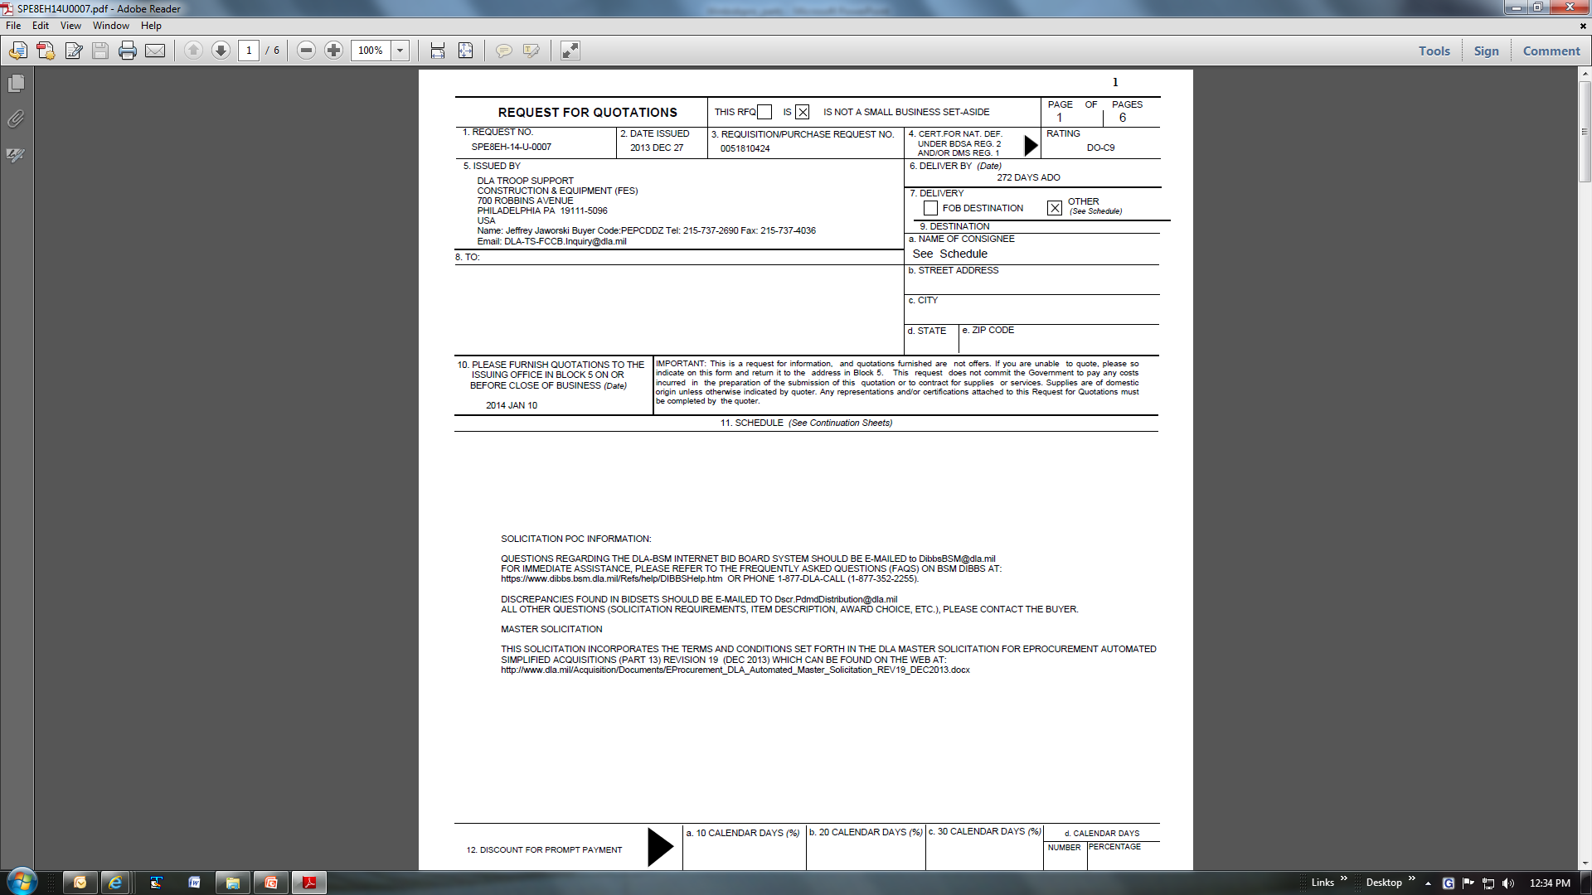
By opening the solicitation link- the user goes directly to the Government bid opportunity

Slide 7
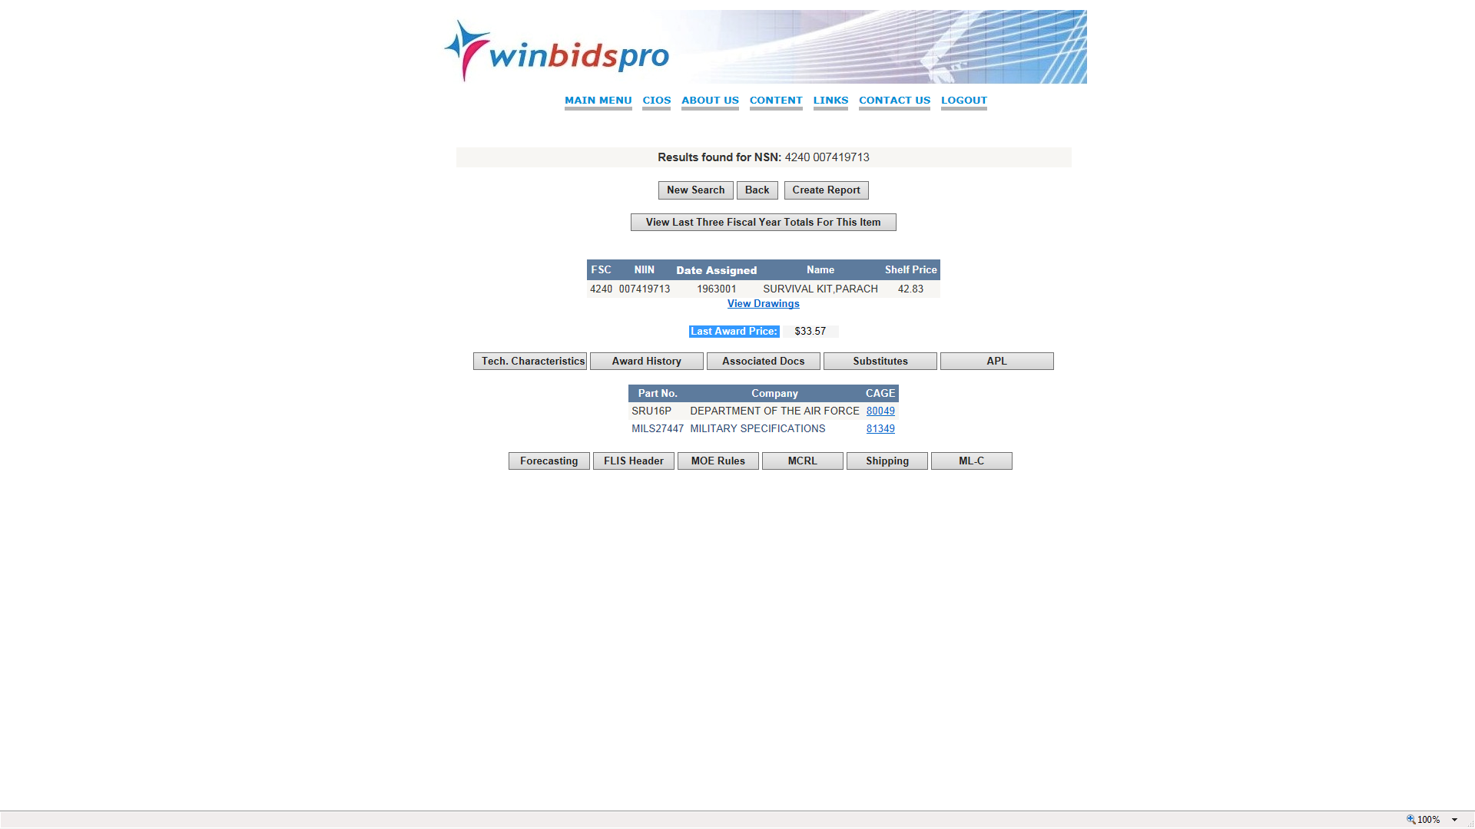
Home | Why NVSBC | Content | Training | Contact Us | Logout
The technical National Stock data is the most complete anywhere in the country - only the Government displays drawings and complete technical data and then only at the time of the bid WinBids Pro maintains the database 24x7 including 4.3 million prices - 4.2 million technical characteristics - 1.2 million drawings sets Military and Federal Specs associated with parts, replacement items and so on- prices are provided as to what the “last price paid” was as well as what the DoD charges itself as “shelf price” Shipping and packaging data is also provided

Slide 8
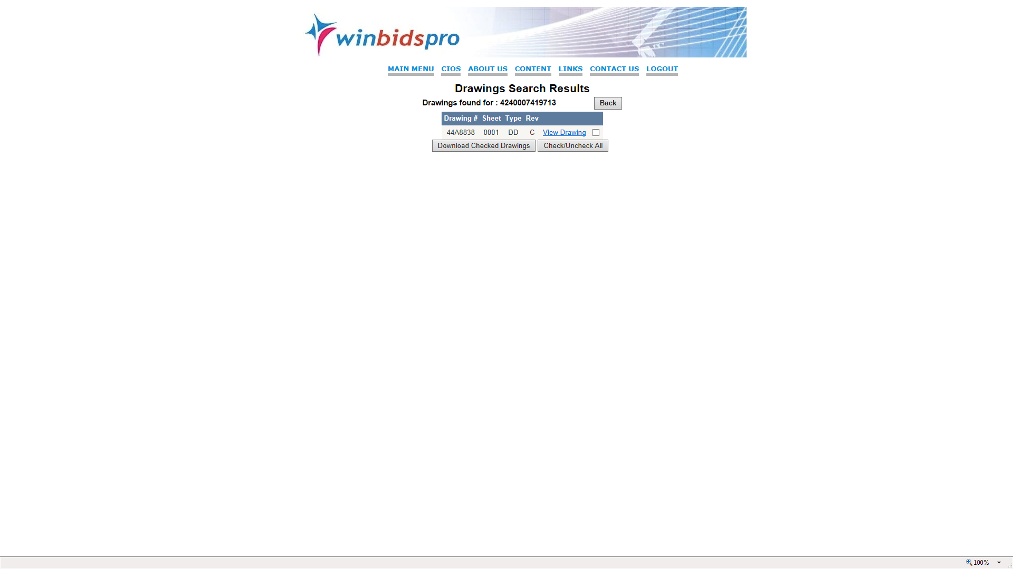
Home | Why NVSBC | Content | Training | Contact Us | Logout
Drawings are provided 24x7 and these drawing are key to successfully bidding on Government contracts- only the DoD has this data presently and it is available only at the time of bidding while WinBids Pro maintains this data 24x7- another unique feature- data is converted from a DoD format to PDF prior to use by WinBids Pro clients

Slide 9
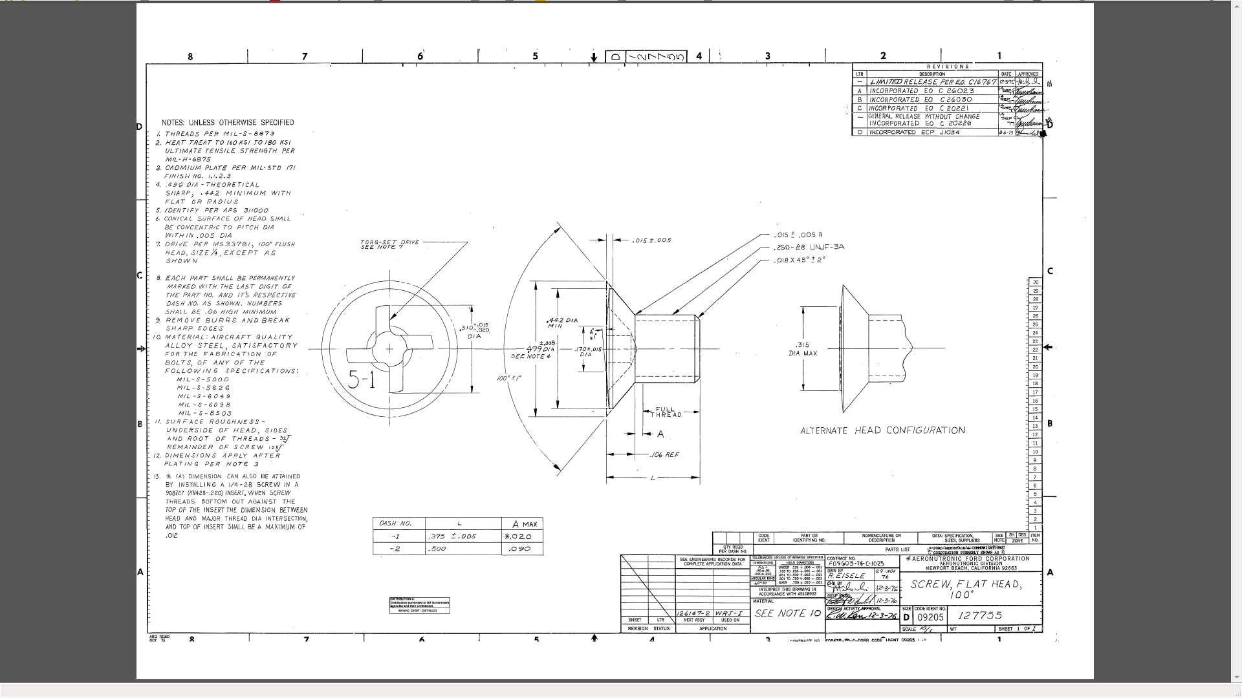

Slide 10
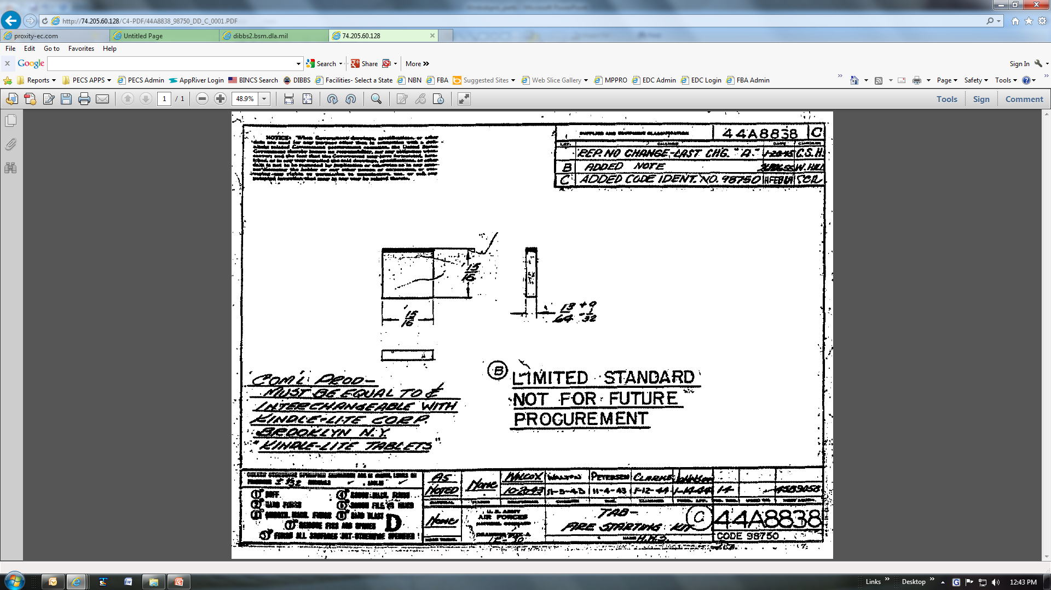

Slide 11
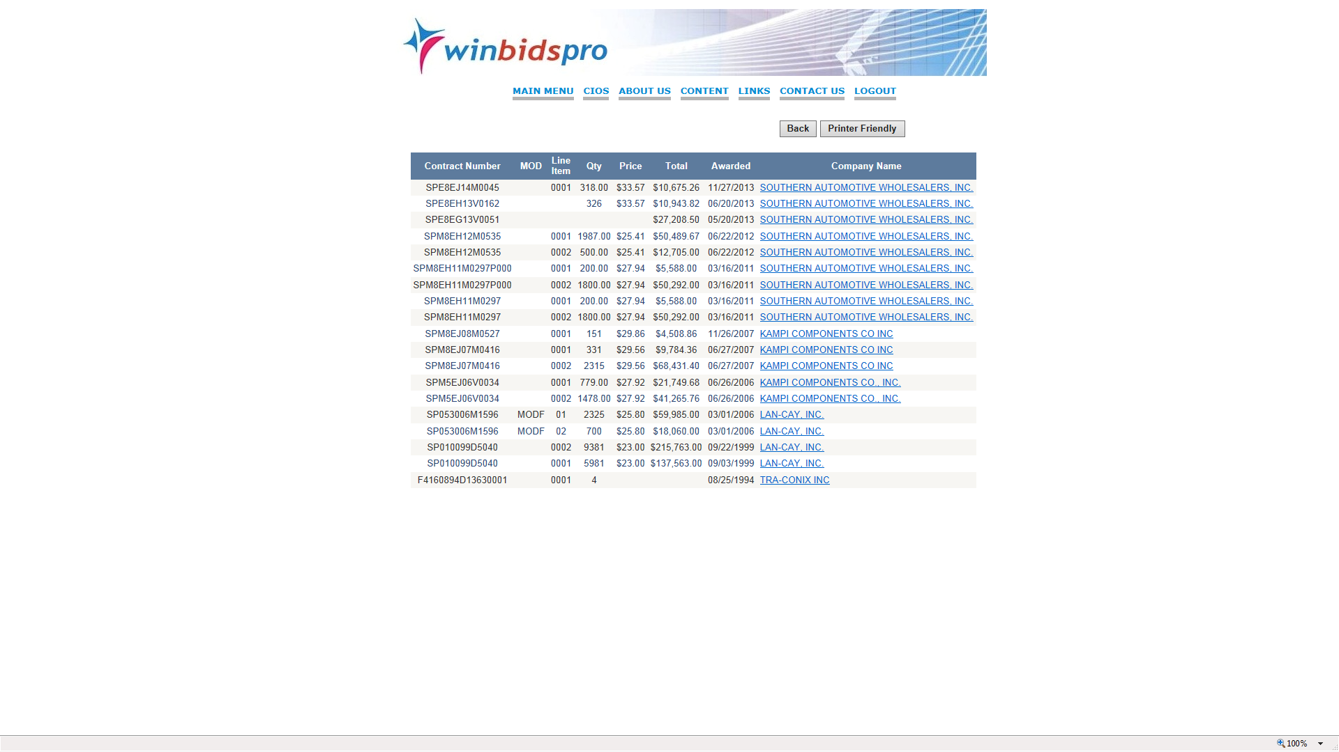
Home | Why NVSBC | Content | Training | Contact Us | Logout
Award history shows contractor awards back to 1965 and includes price, contract award number, number of units and award price. By clicking on the hyperlink of the contractor user will go contractor catalog of history and contact data

Slide 12
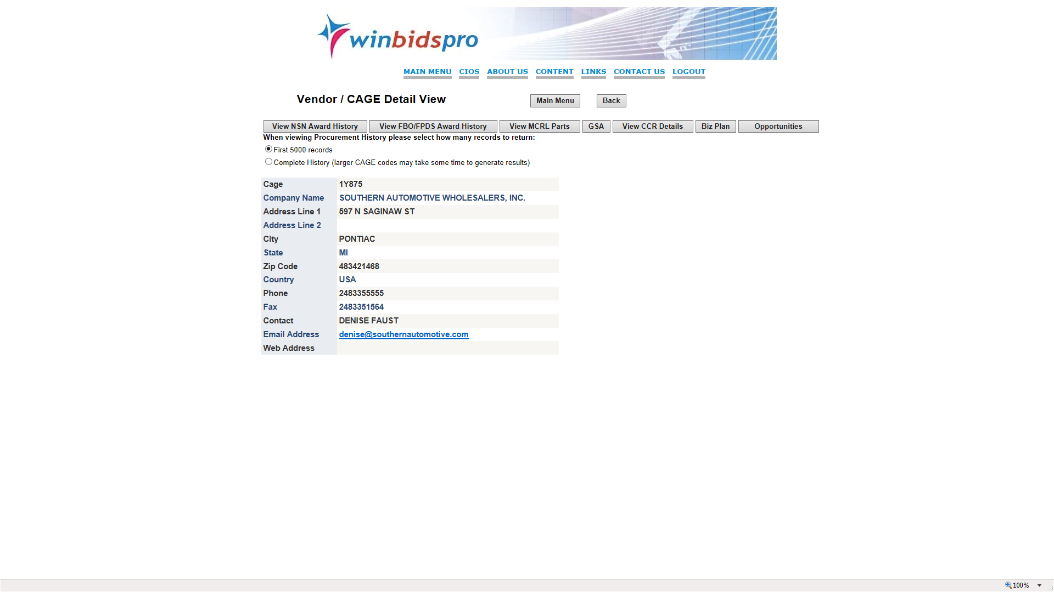
Home | Why NVSBC | Content | Training | Contact Us | Logout
Contractor database includes award history, key contact data in hundreds of thousands of cases as well as awards for parts and services. System provides listing of DoD preference for contractor parts in MCRL WinBids Pro provides 400,000 emails

Slide 13
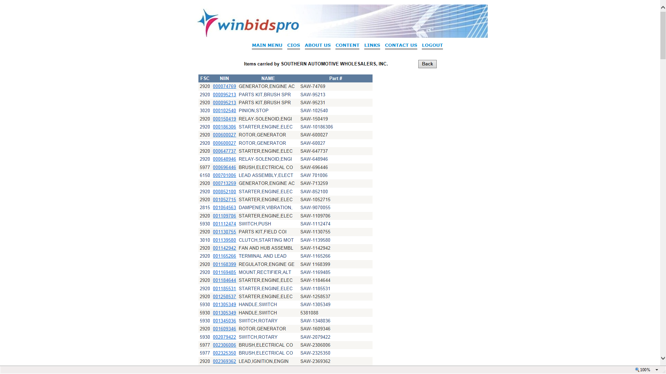
Home | Why NVSBC | Content | Training | Contact Us | Logout
In the MCRL database within vendor database is a list of the list of products sold to the DoD where the DoD states that the vendor is a “source of supply” NSN link takes user to NSN database

Slide 14
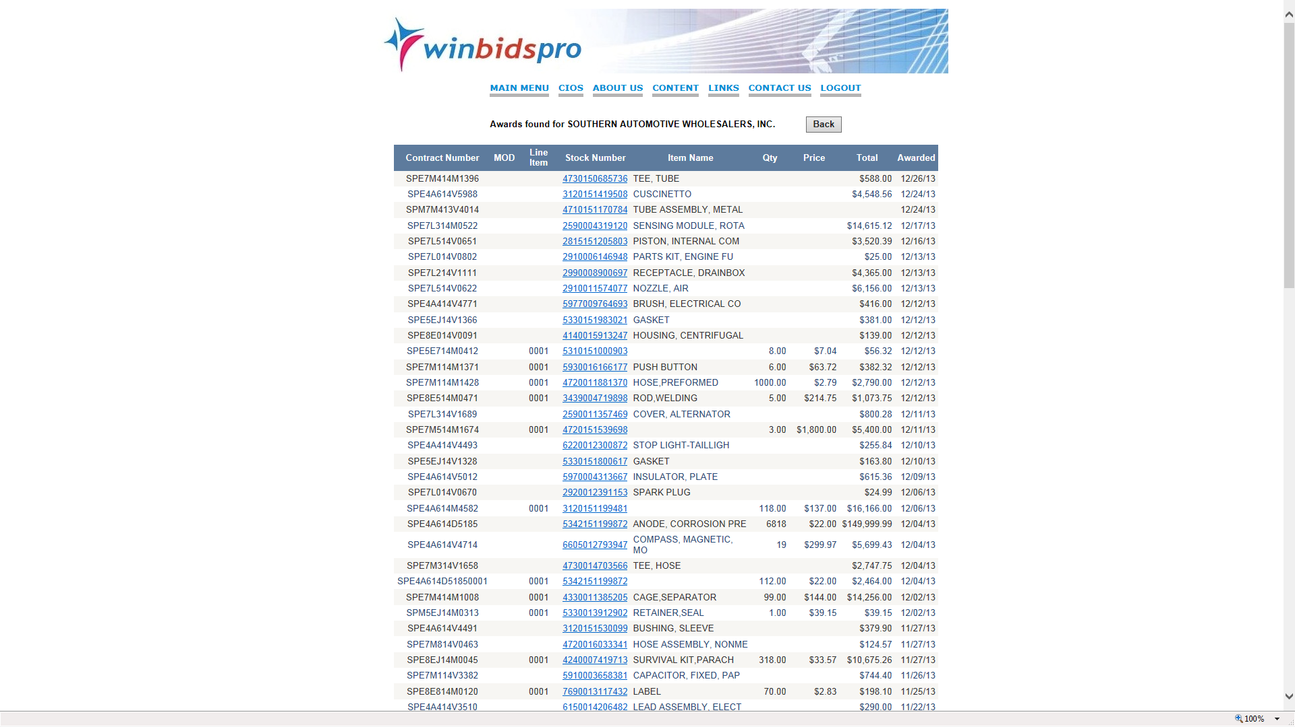
Home | Why NVSBC | Content | Training | Contact Us | Logout
Vendor Award history shows details of all awards going back to 1965 - link from stock number redirects to NSN database

Slide 15
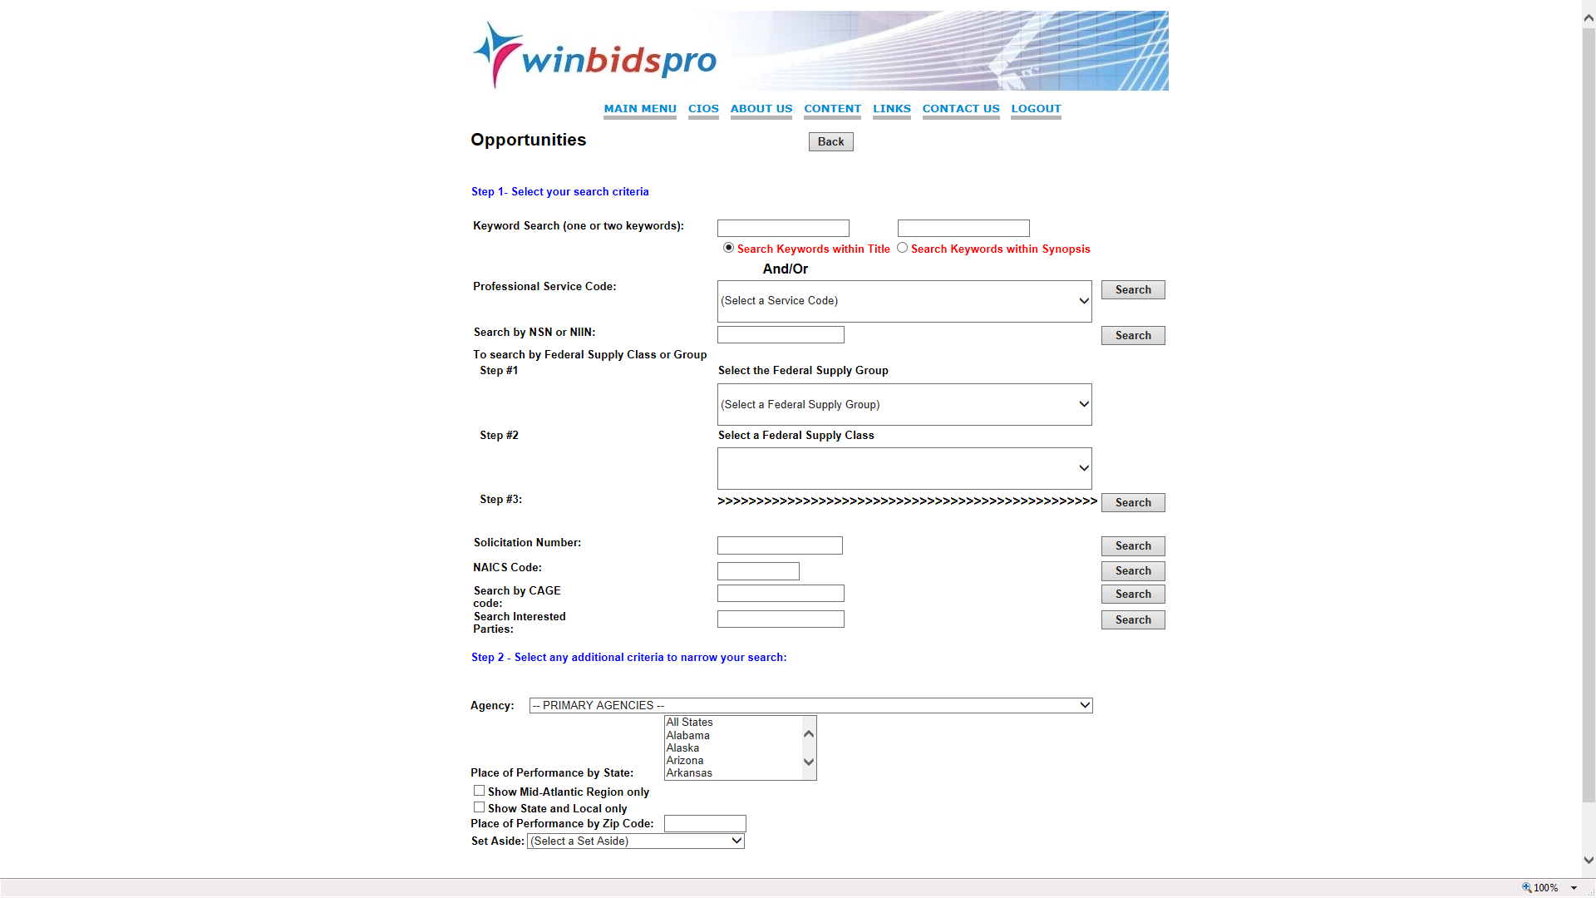
Home | Why NVSBC | Content | Training | Contact Us | Logout
Once the user has assisted in building a profile of key words or NSN or NAICS or Federal Supply Classes which are monitored for daily bids
The user will receive daily notices however the system allows users to manually check for bid opportunities in a variety of means including key words, NO OTHER system Government or industry provides this feature

Slide 16
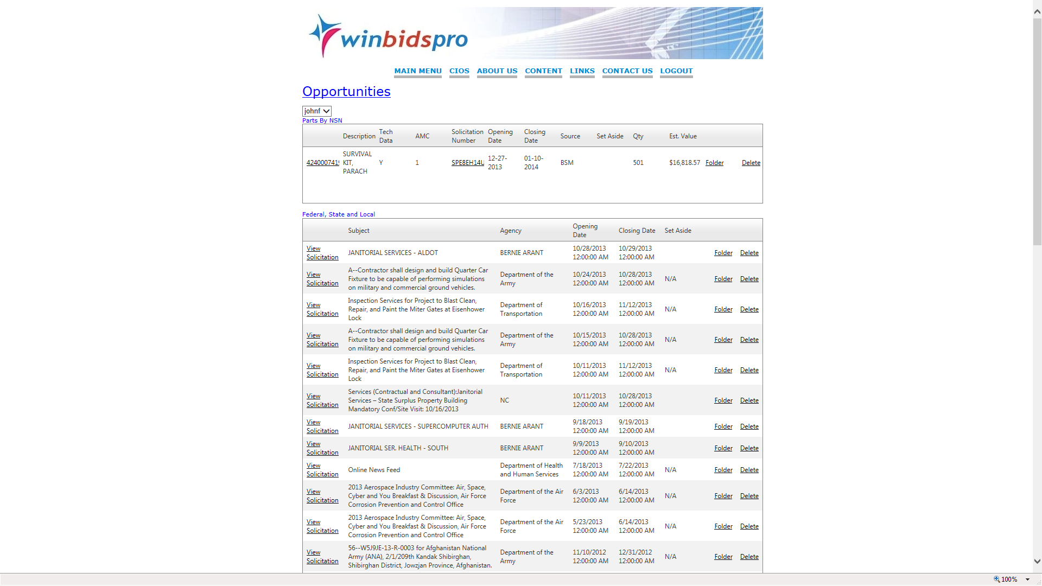
Home | Why NVSBC | Content | Training | Contact Us | Logout

Slide 17
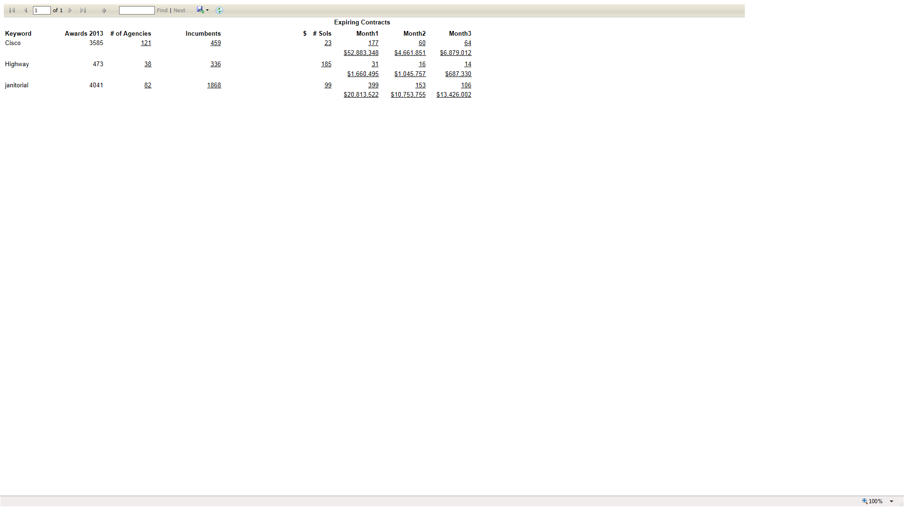

Slide 18
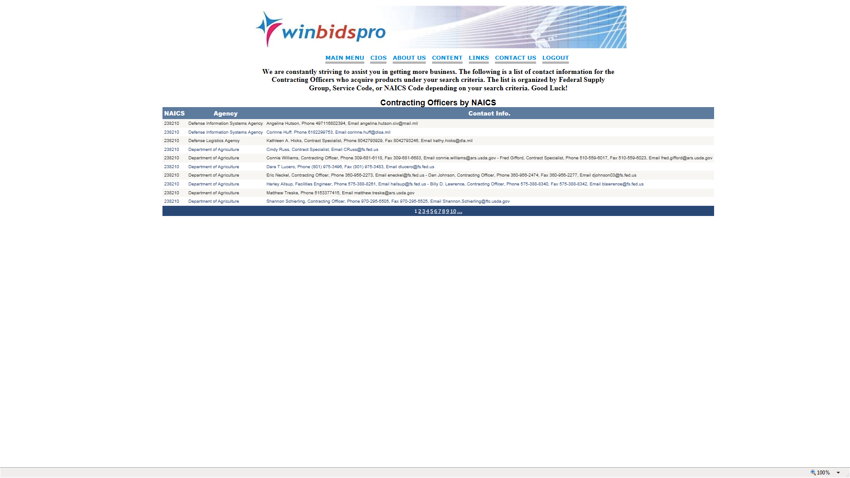
Home | Why NVSBC | Content | Training | Contact Us | Logout

Slide 19
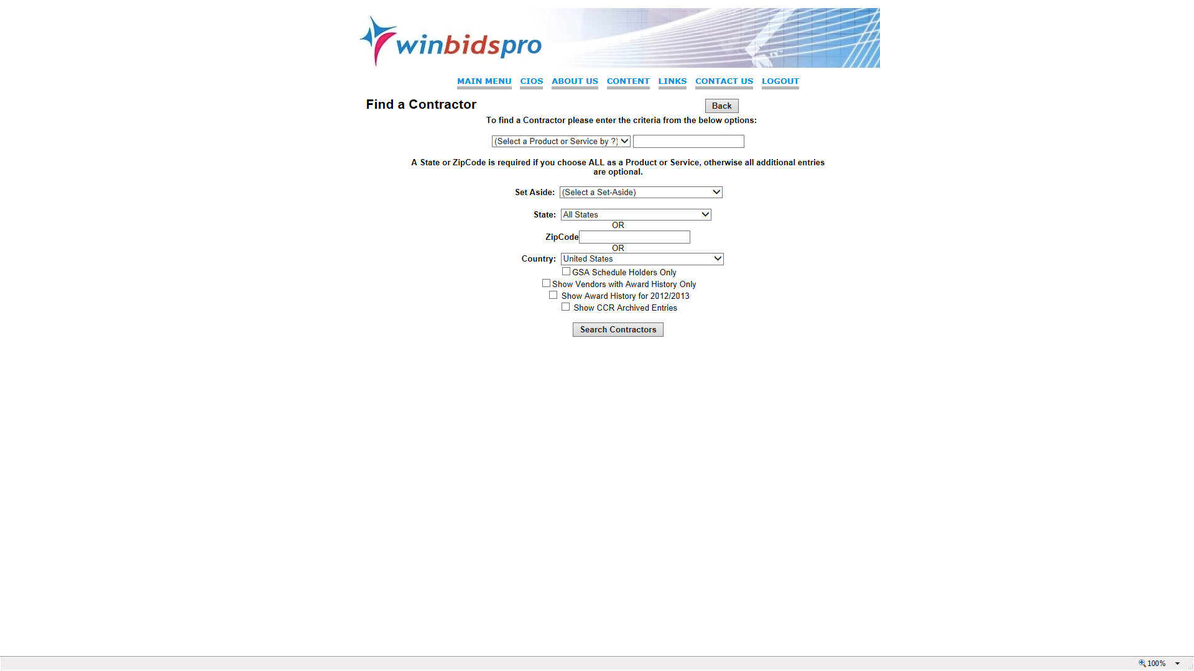
In the vendor search- user may search using any number of combination of search criteria to prospect in the commercial world by zip or key word, company name, and other search methods- there is a second pull down box which allows two search methods plus searching within a state- another totally unique feature of WinBids Pro

Slide 20
Home | Why NVSBC | Content | Training | Contact Us | Logout
Contractor database includes award history, key contact data in hundreds of thousands of cases as well as awards for parts and services. System provides listing of DoD preference for contractor parts in MCRL WinBids Pro provides 400,000 emails

Slide 21
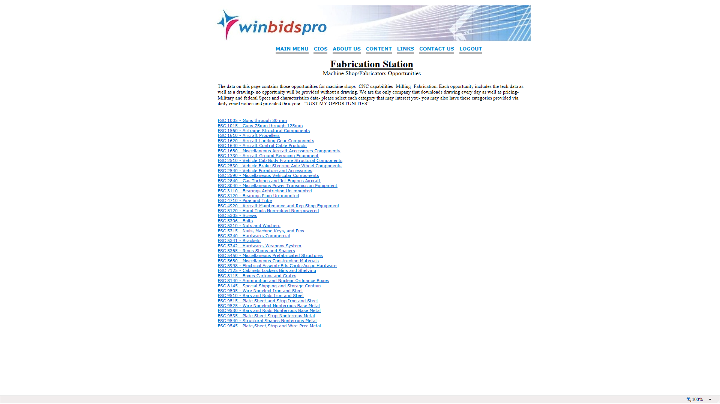
Home | Why NVSBC | Content | Training | Contact Us | Logout

Slide 22
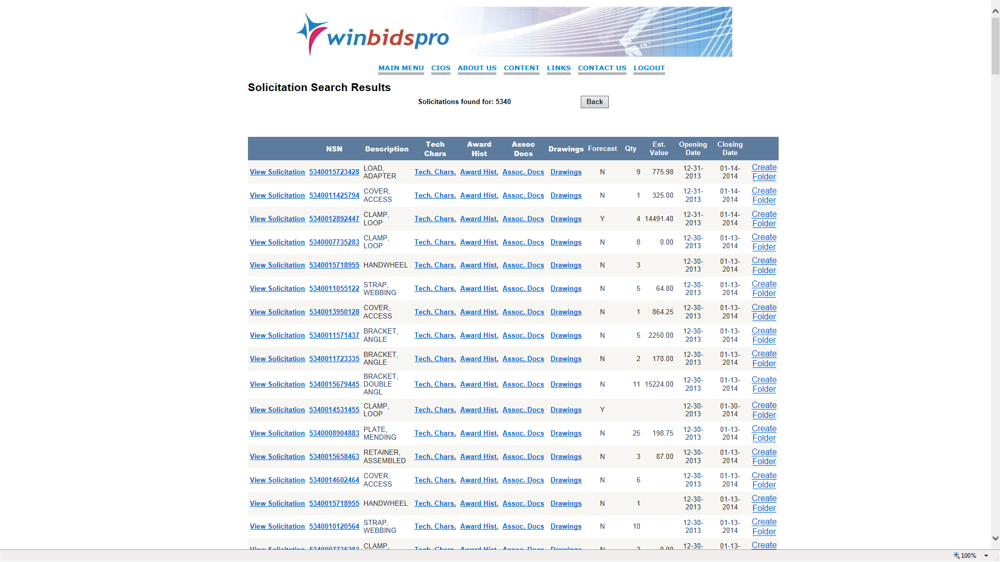
Home | Why NVSBC | Content | Training | Contact Us | Logout

Slide 23
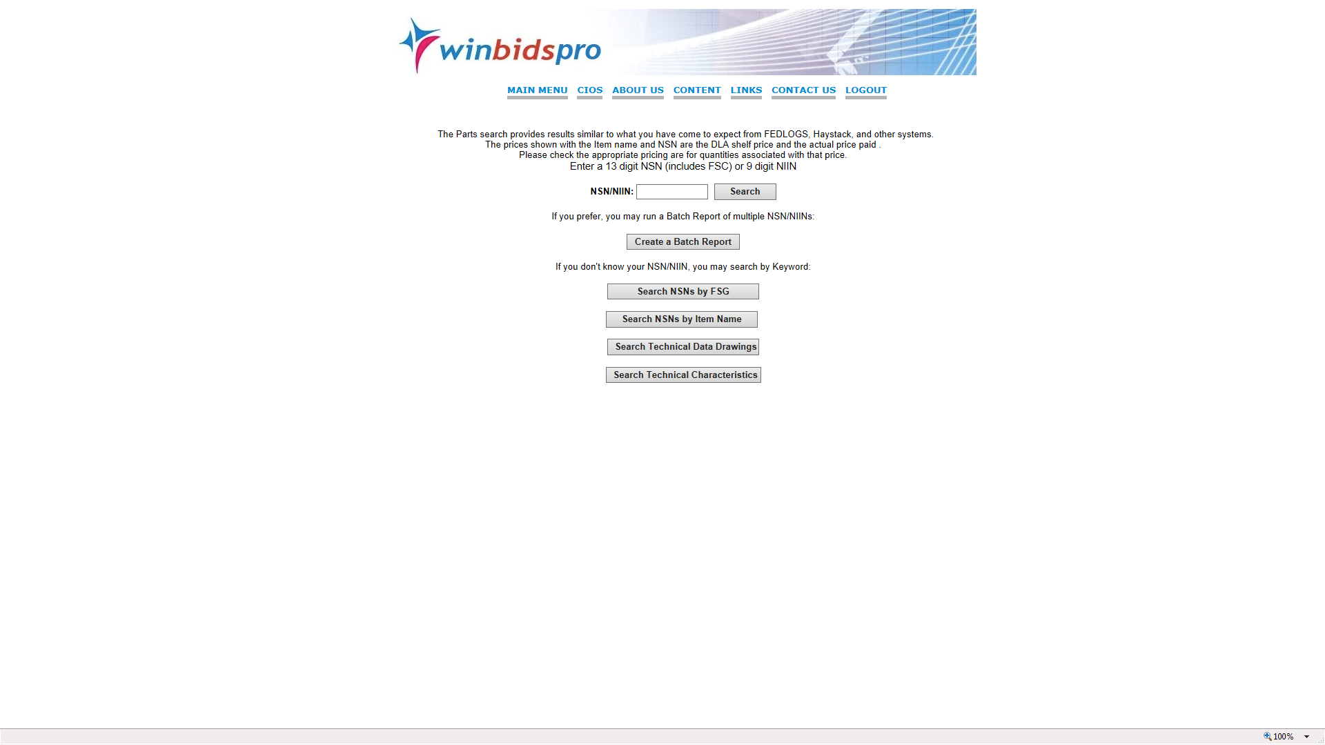
Home | Why NVSBC | Content | Training | Contact Us | Logout
In cases of research to review all details of data pertaining to a National Stock Number, the company provides several methods to determine if there is a National Stock Number on a product and if so provide all salient tech data and prices

Slide 24
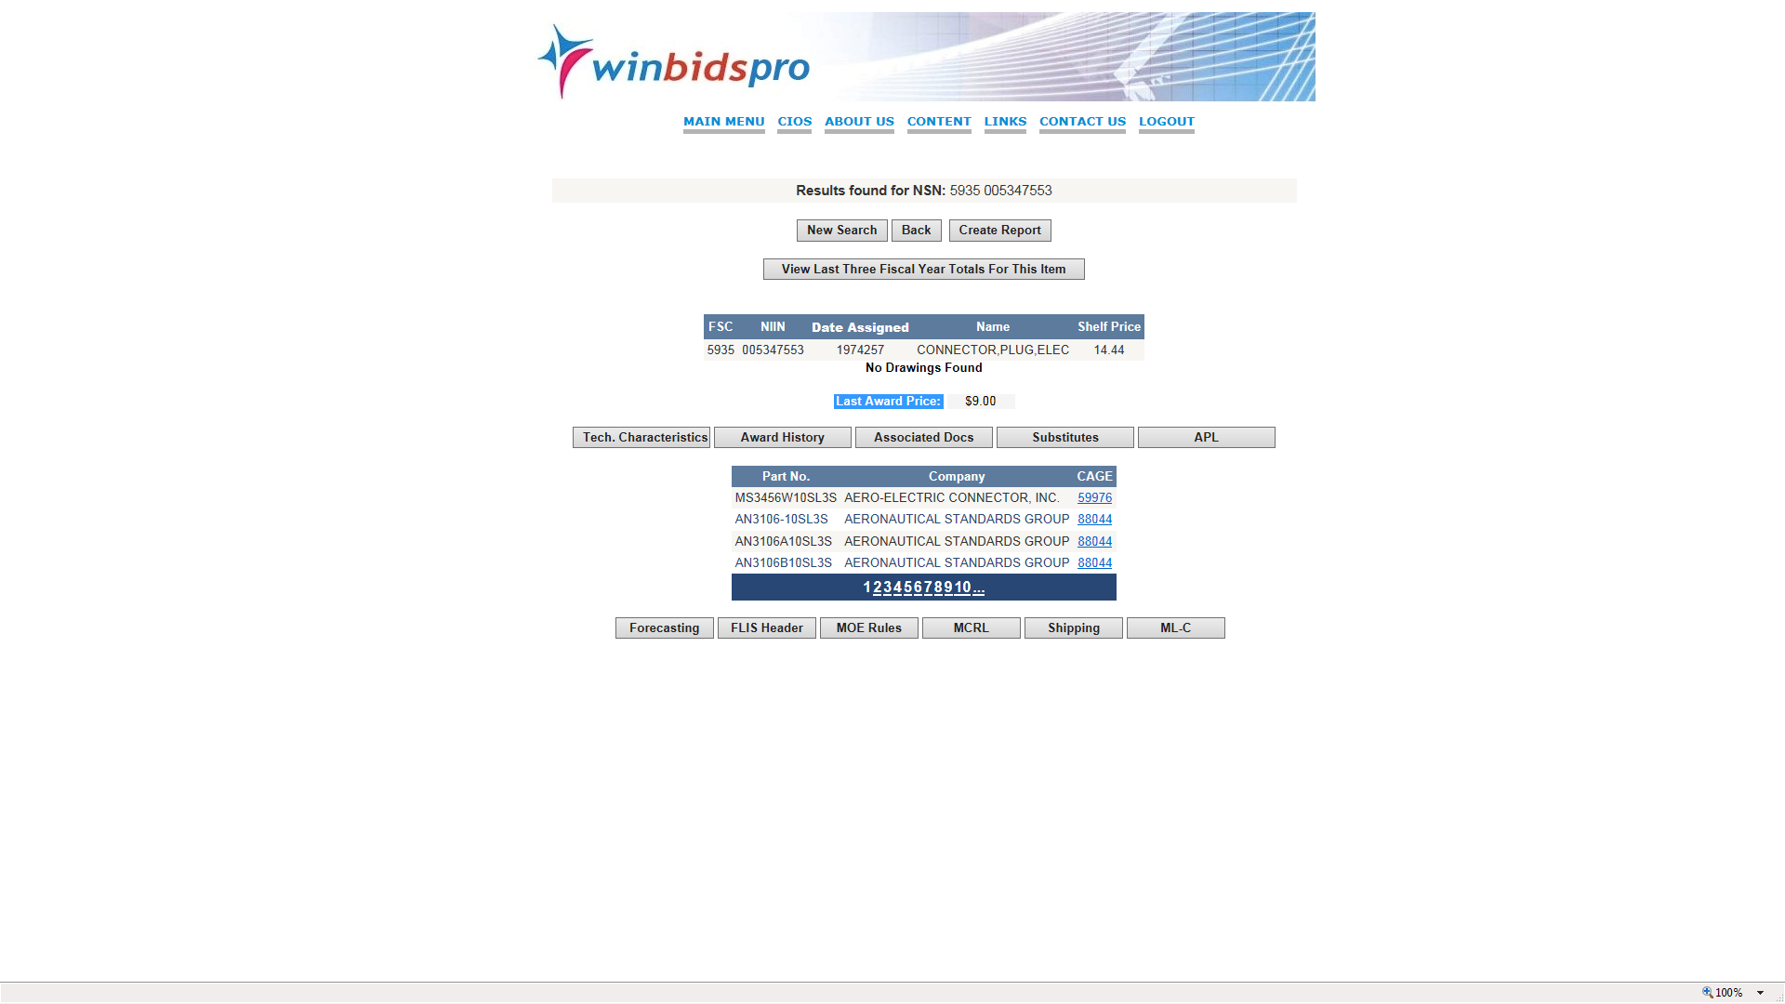
Home | Why NVSBC | Content | Training | Contact Us | Logout

Slide 25
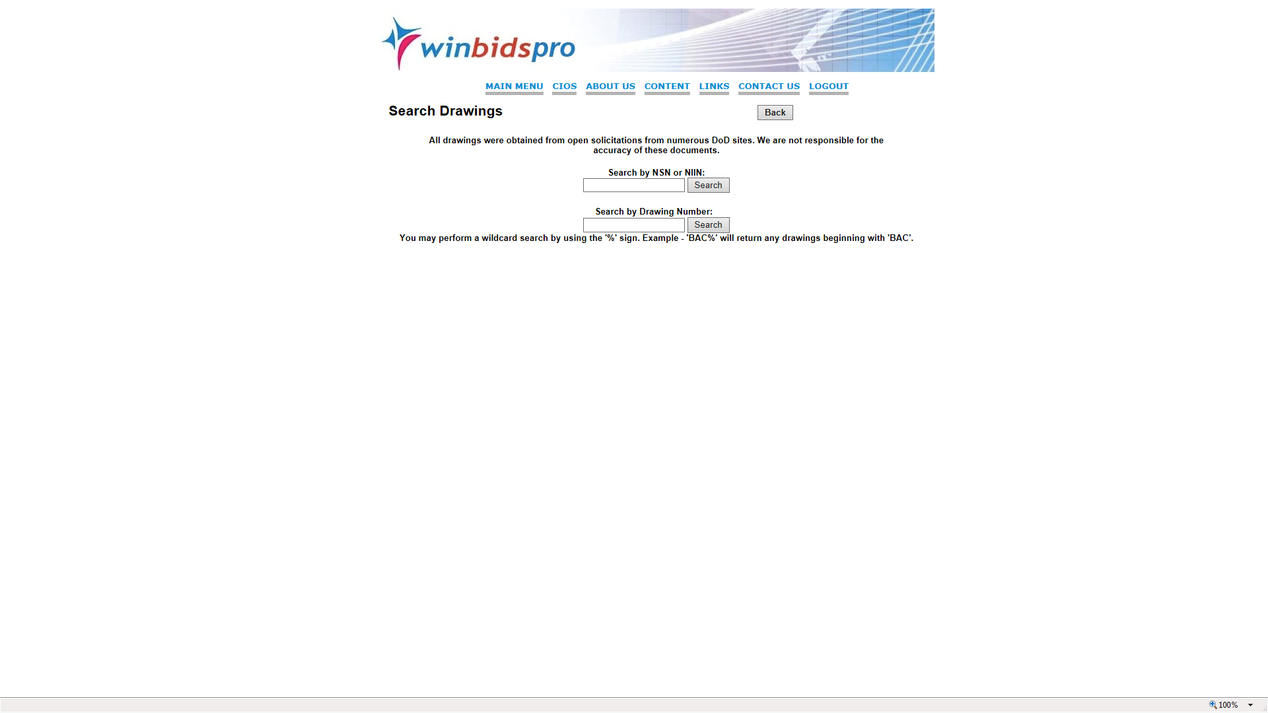
Home | Why NVSBC | Content | Training | Contact Us | Logout

Slide 26
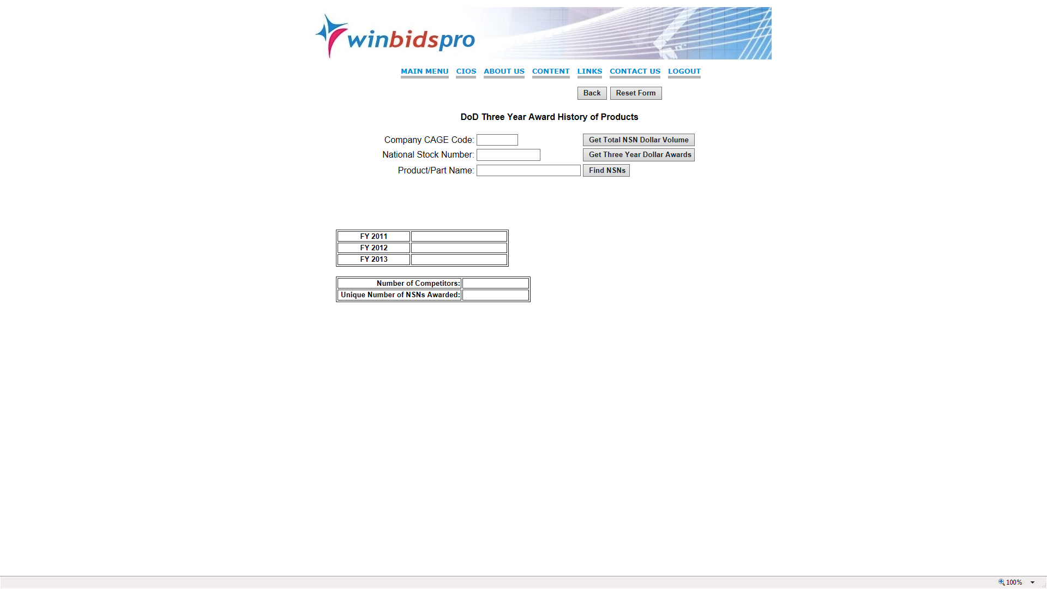
Home | Why NVSBC | Content | Training | Contact Us | Logout

Slide 27
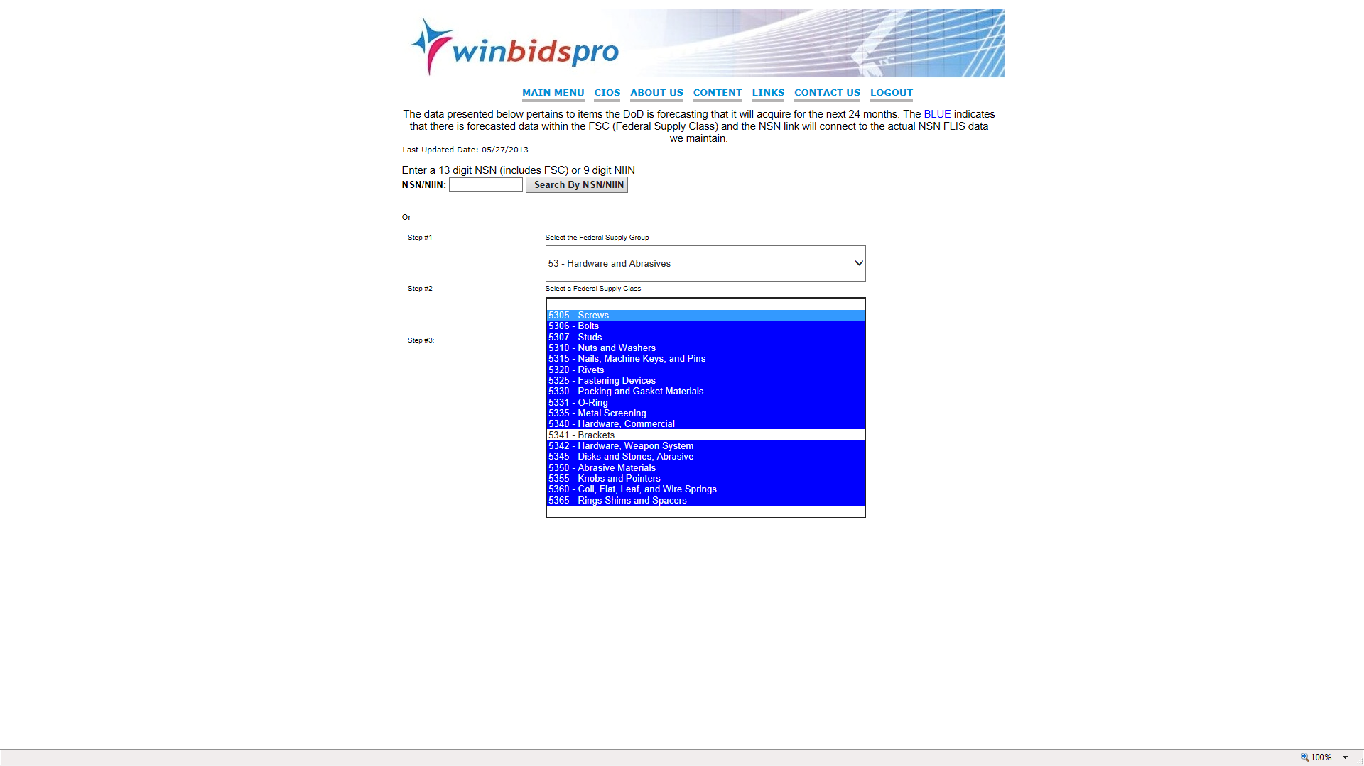

Slide 28
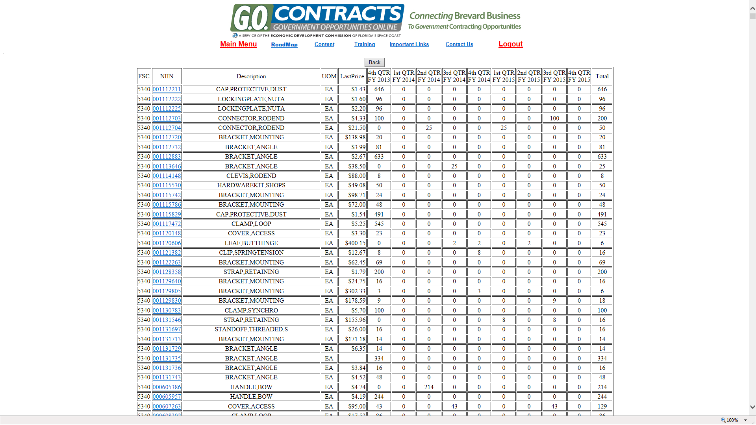
Home | Why NVSBC | Content | Training | Contact Us | Logout

Slide 29
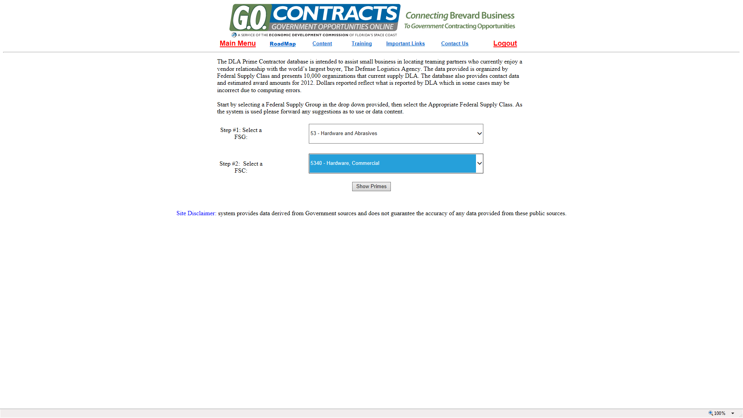
Home | Why NVSBC | Content | Training | Contact Us | Logout

Slide 30
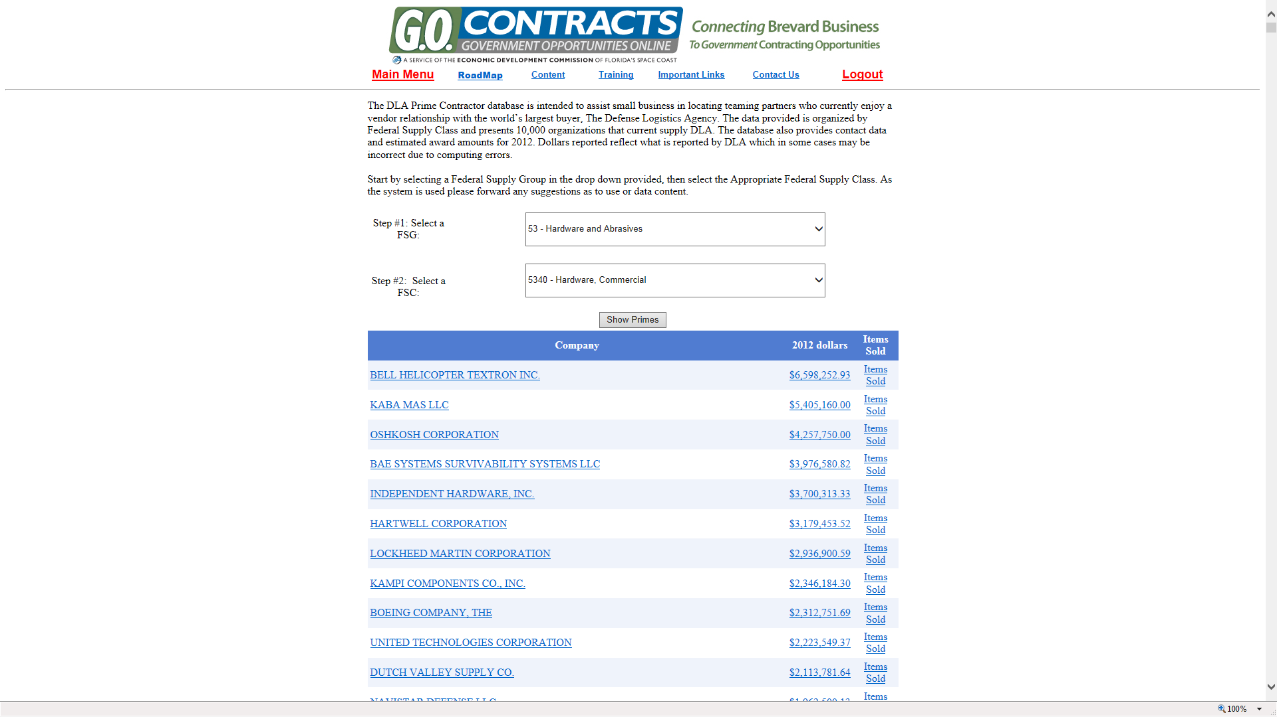
Home | Why NVSBC | Content | Training | Contact Us | Logout

Slide 31
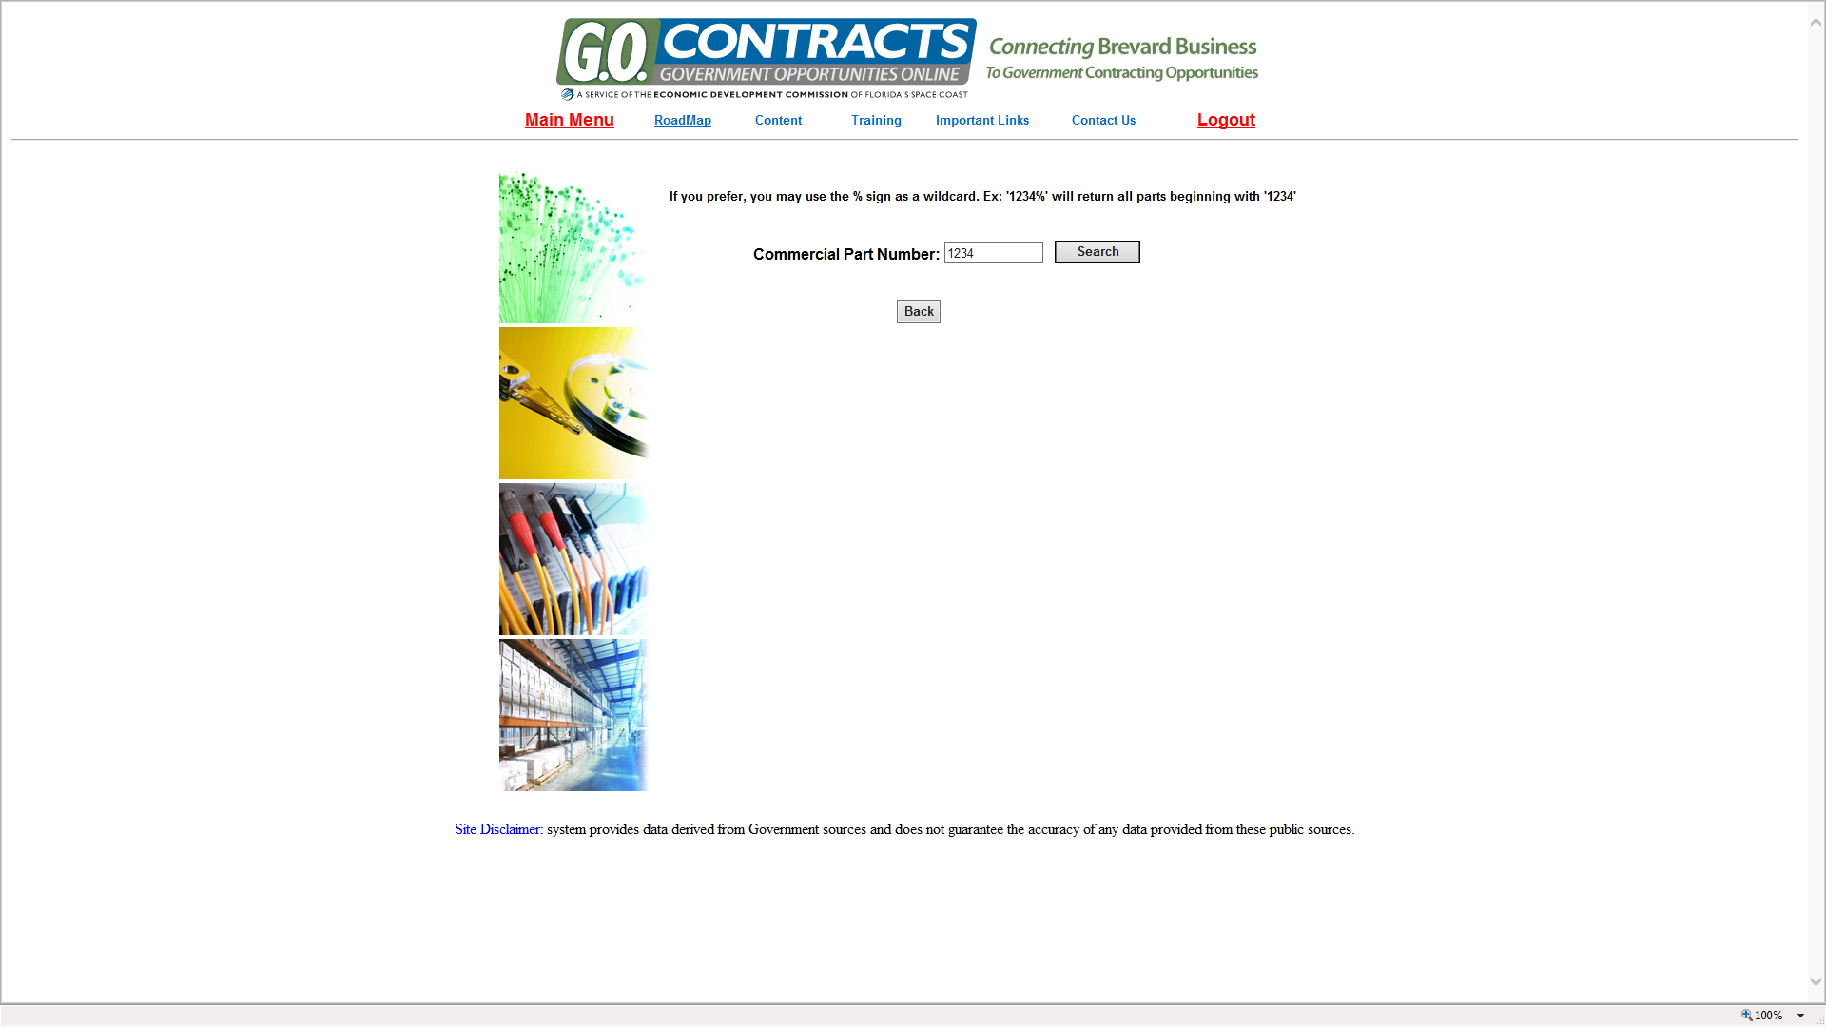
Home | Why NVSBC | Content | Training | Contact Us | Logout
Many times the user will have a supplier’s commercial part number, desiring to match that to a National Stock Number - theWinBids Pro system maintains a list of 12,000,000 commercial part numbers

Slide 32
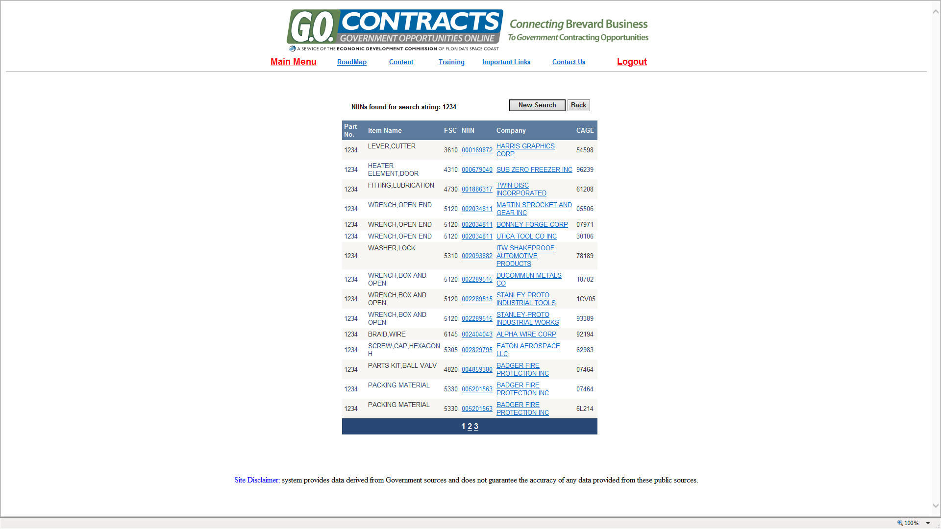
Home | Why NVSBC | Content | Training | Contact Us | Logout
Results of a commercial part number search will provide the corresponding NSN as well as supplier name and contact data

Slide 33
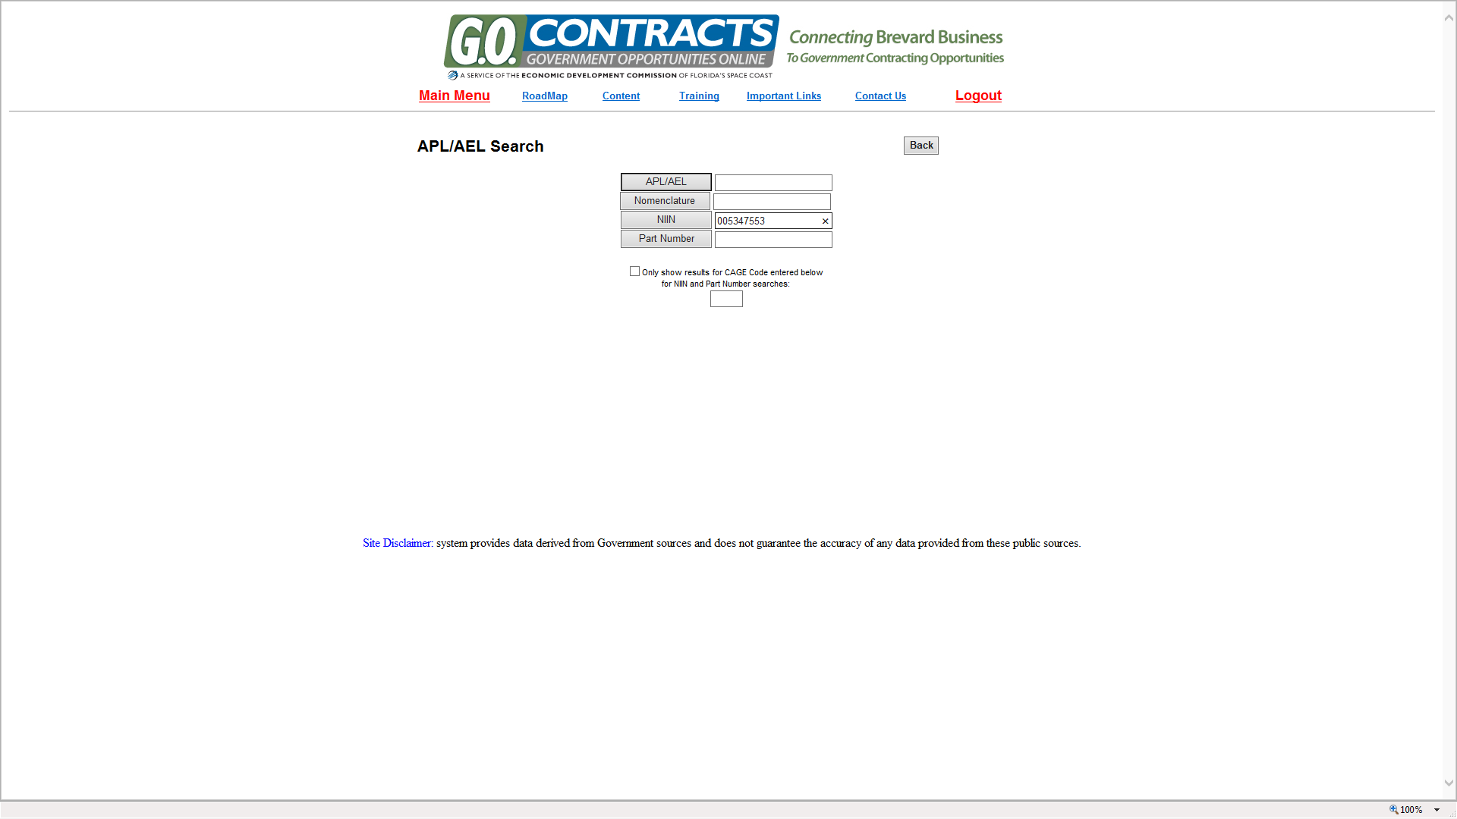
Home | Why NVSBC | Content | Training | Contact Us | Logout

Slide 34
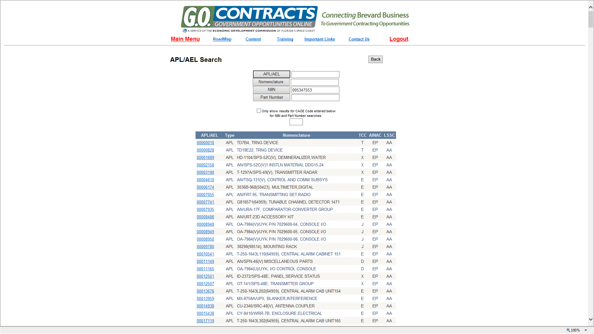
Home | Why NVSBC | Content | Training | Contact Us | Logout

Slide 35
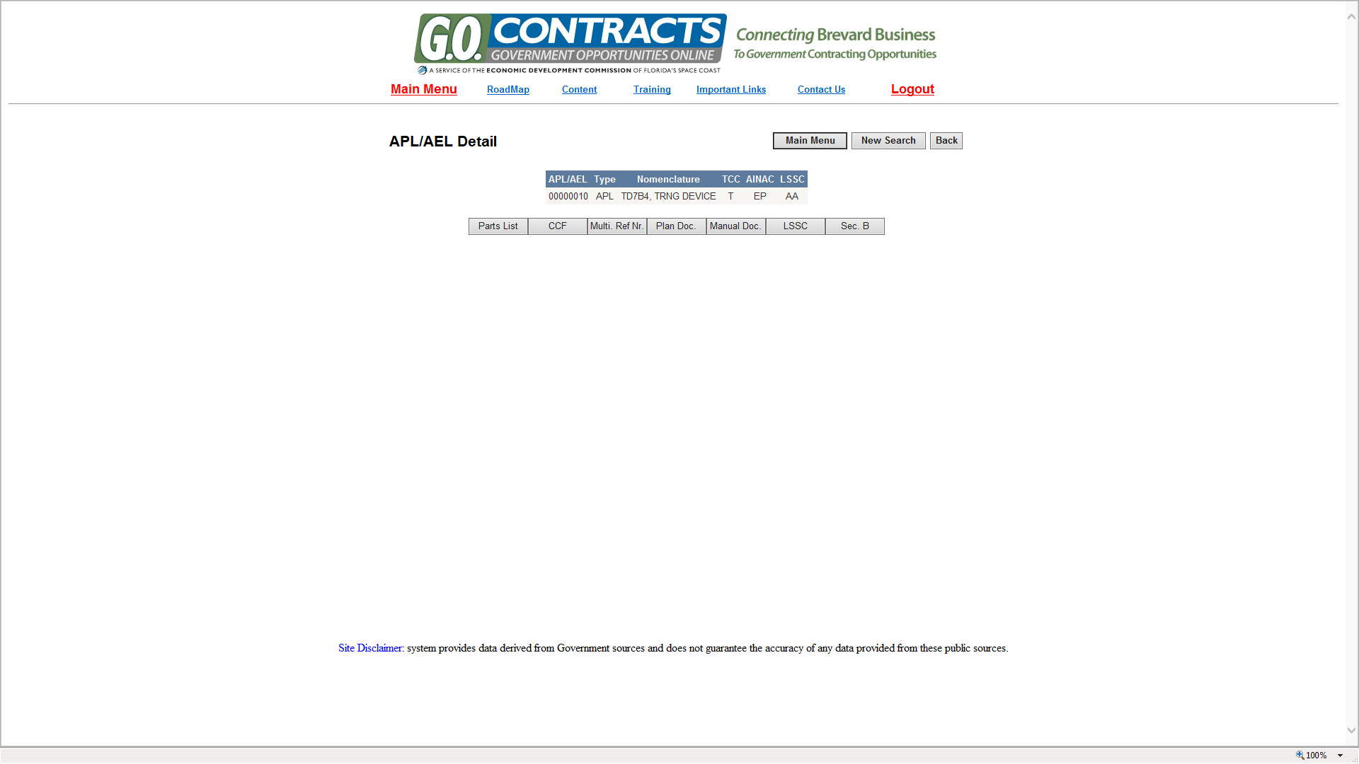
Home | Why NVSBC | Content | Training | Contact Us | Logout

Slide 36
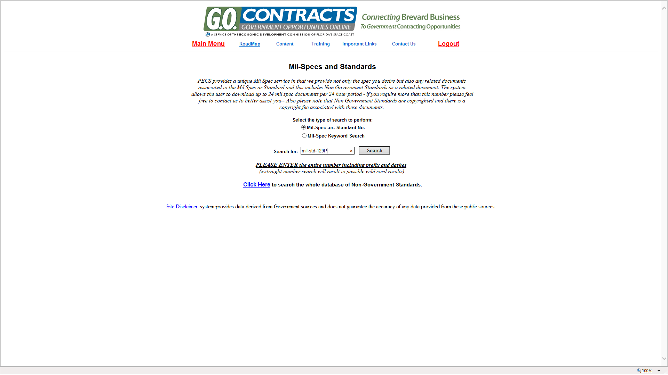
Home | Why NVSBC | Content | Training | Contact Us | Logout
Each part or product that the Government uses has Military/Federal and or commercial standards – how to maintain, package, ship, use, Install - anything involved with the product -WinBids Pro maintains that data

Slide 37
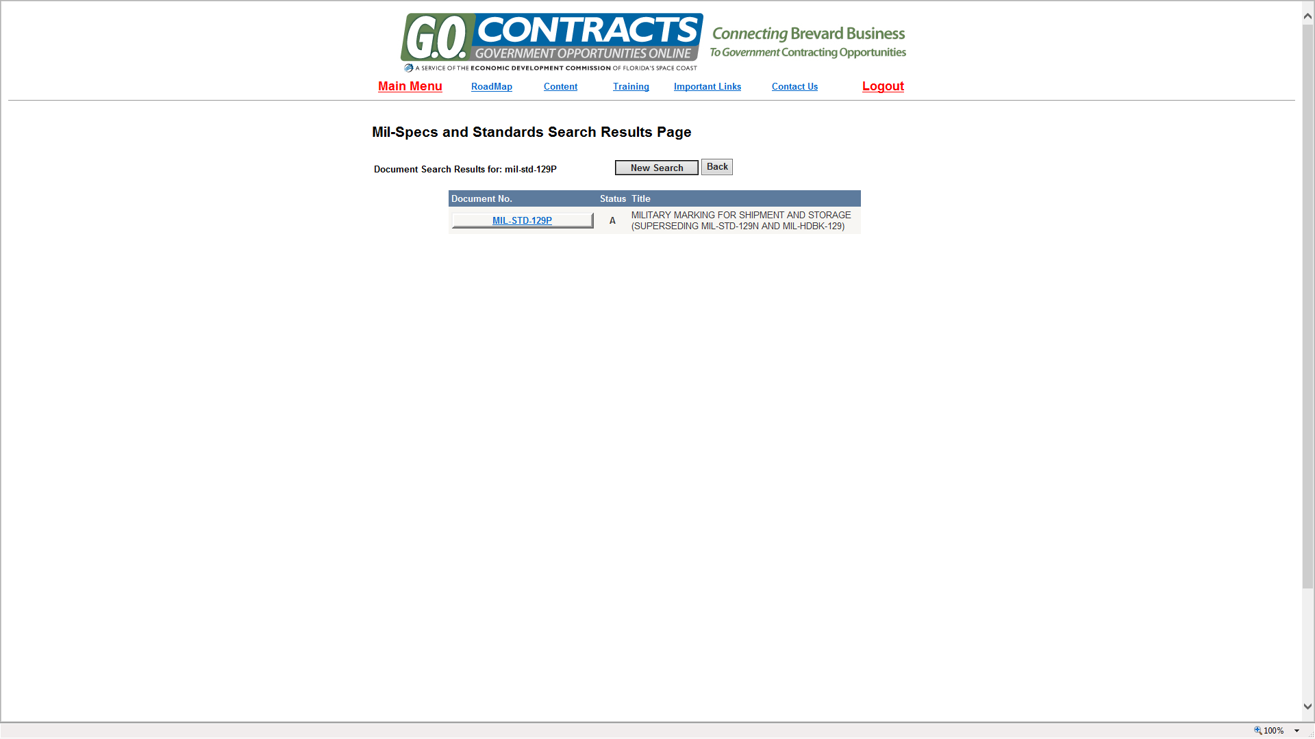
Home | Why NVSBC | Content | Training | Contact Us | Logout
Once a Mil number has been entered into the system and a bio of the document appears, by clicking on the hyperlink the document will appear as a PDF

Slide 38
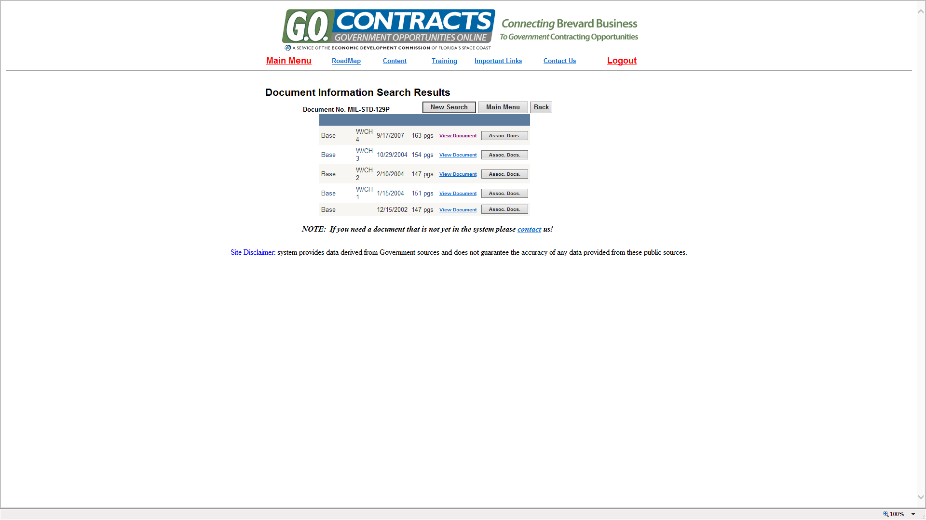
Home | Why NVSBC | Content | Training | Contact Us | Logout

Slide 39
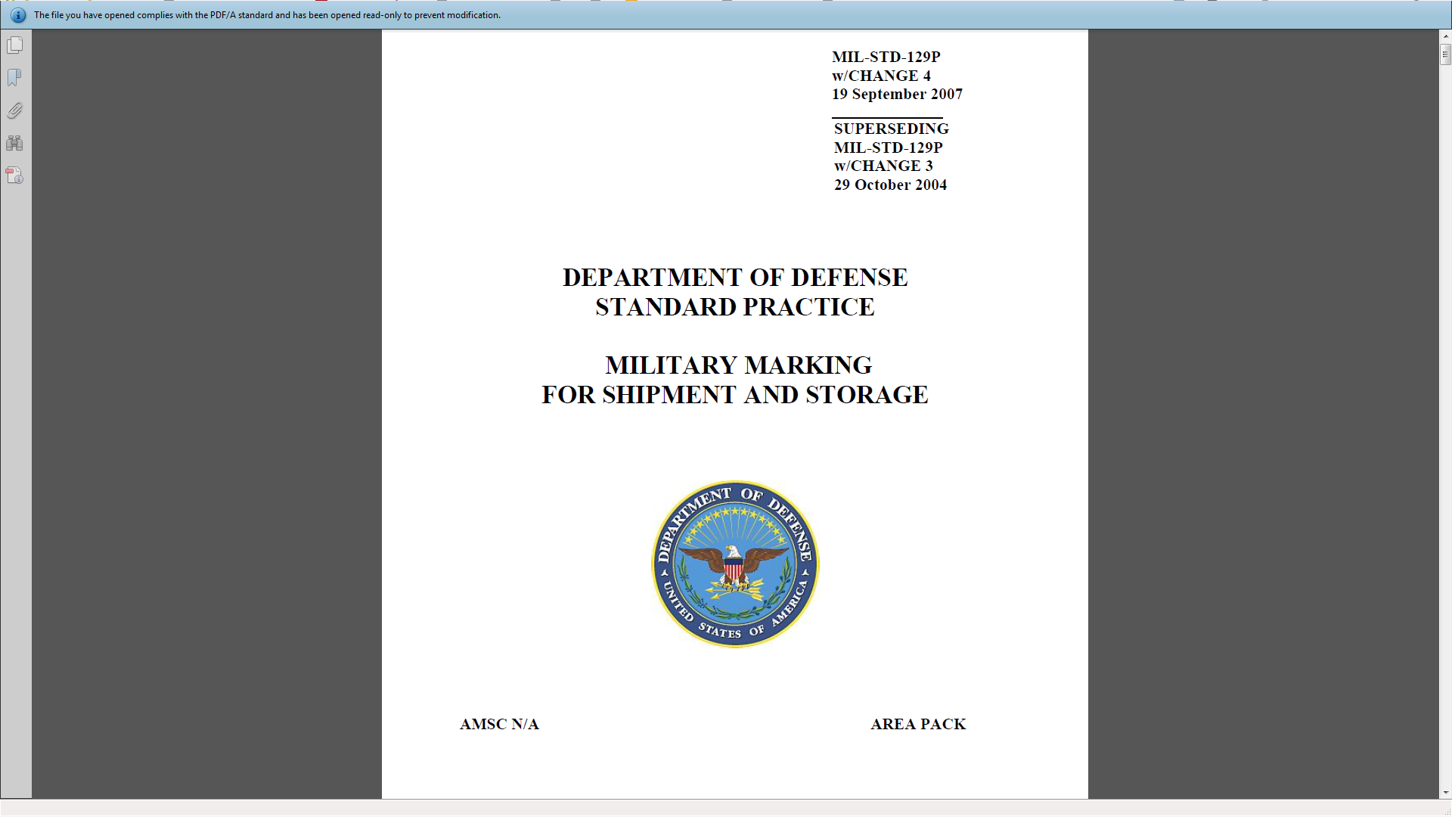

Slide 40
Daily Bids; 700,000 contractors; 55,000 contracting officers; DoD directory;
subcontracting partners; national stock number database and MORE!
SUMMARY- NO OTHER COMPANY OR GOVERNMENT ORGANIZATION HAS ALL THE DATA CONTAINED IN THE GovBidmatch DATABASE

